Slide 1
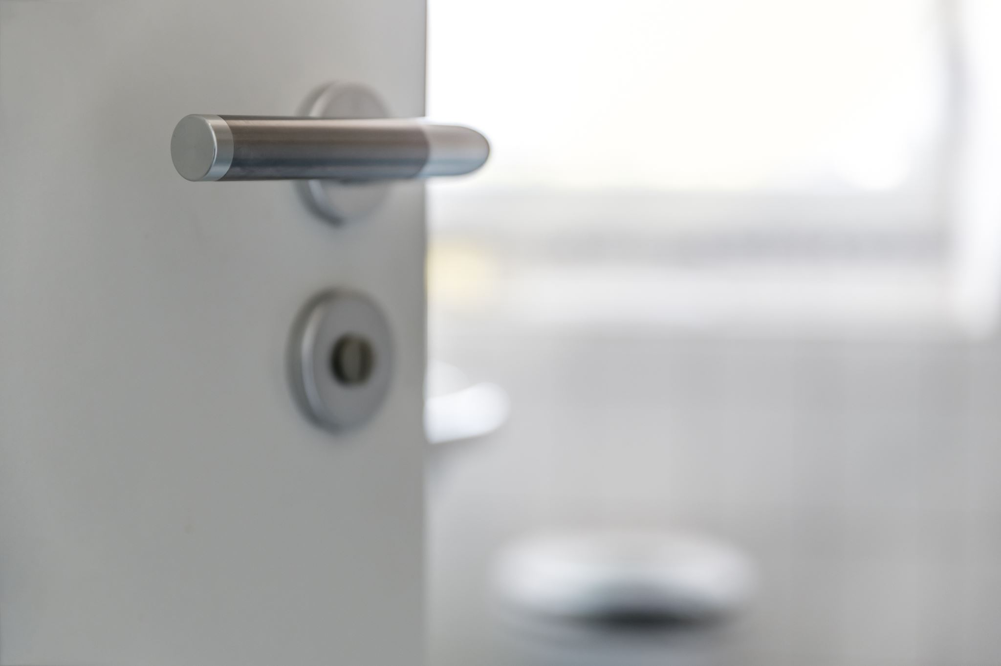
GuardAnywhere: Remote Secure Door System
Team Members:
Amin Nouri
Khaled Al-Qadi
Hasan Al Zubaidi
Supervisor:
Professor Laith Shehab

Slide 2
Introduction
The IoT-Based Secure Door Access System leverages IoT and RFID technology to create a smart door that provides secure, remote-controlled access. This project aims to develop an access control system that uses RFID tags for authentication and integrates with the Blynk app for remote monitoring and control.

Slide 3

Components
RC522 RFID Module
Active Buzzer
SG90 Servo Motor
ESP32
Blynk App

Slide 4
System Design
Access Control:
RFID Tag Reading:
Authorized and Unauthorized Access
Servo Motor:
Door Operation
Blynk App:
Real-time Notifications
Status Display

Slide 5

Circuit Design
The hardware components are interconnected as follows:
The RC522 RFID module is connected to the ESP32 to read RFID tags.
The active buzzer is connected to the ESP32 to provide audio feedback.
The SG90 servo motor is connected to the ESP32 to control the door movement.
The ESP32 communicates with the Blynk app via Wi-Fi.

Slide 6

Software Development
The system's firmware is written in Arduino IDE and involves:
RFID Tag Reading: Code to read and process RFID tags.
Servo Motor Control: Code to operate the servo motor based on access decisions.
Blynk App Integration: Code to send notifications and update door status.

Slide 7
Testing and Validation
RFID Tag Testing
Buzzer Feedback
Servo Motor Operation
Blynk App Integration

Slide 8
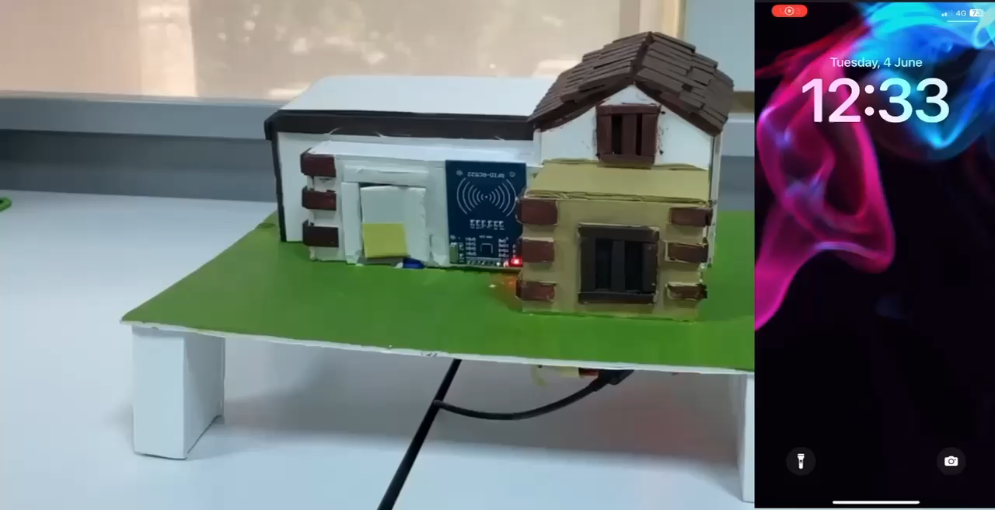
Authorized Access

Slide 9
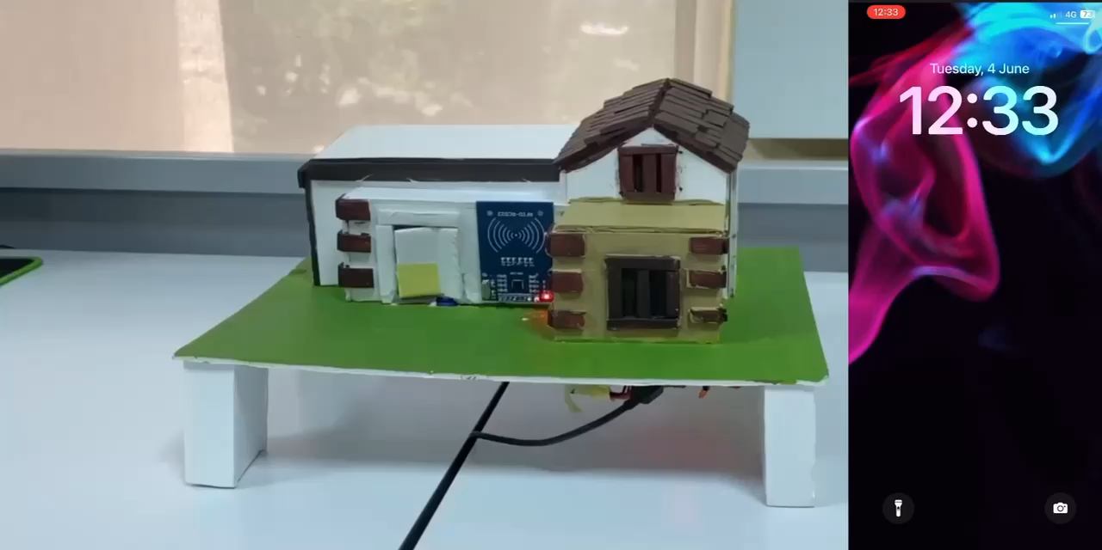
Unauthorized Access

Slide 10
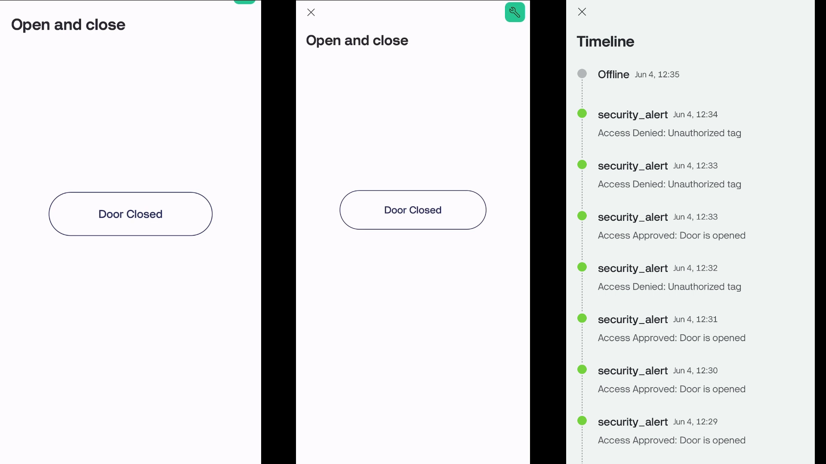
Notification Experience: Blynk App

Slide 11
Conclusion
Successful integration of IoT and RFID technology
Secure, efficient, and user-friendly access control solution
Potential for future innovations in smart security solutions

